Slide 1
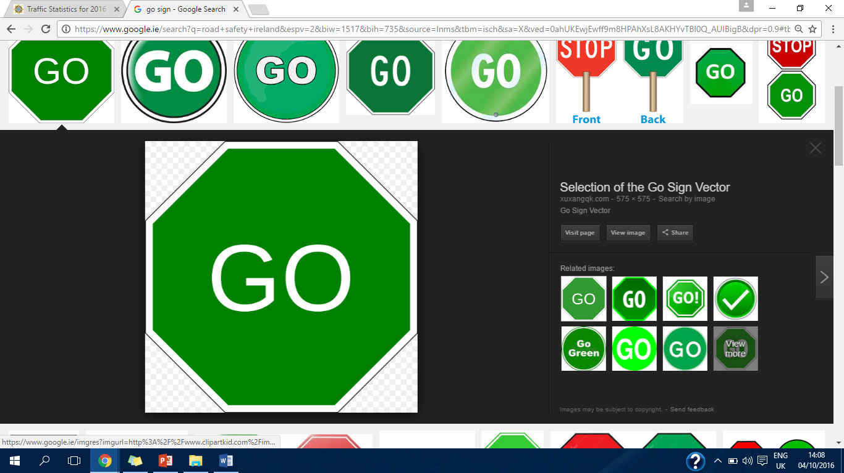
Road deaths in an Irish context.
What are the main issues?
By: Leah Brennan

Slide 2
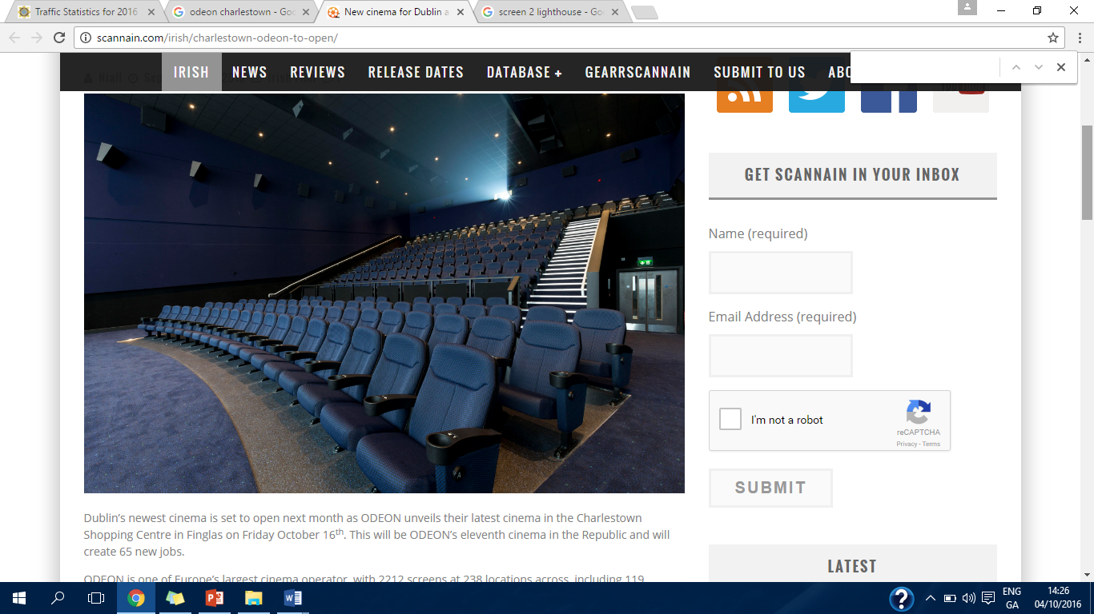
161
(+18 people in one month
+6 people in two weeks)
166
162
Notes:
2012
2015
As of 14:10 06.10.16

Slide 3
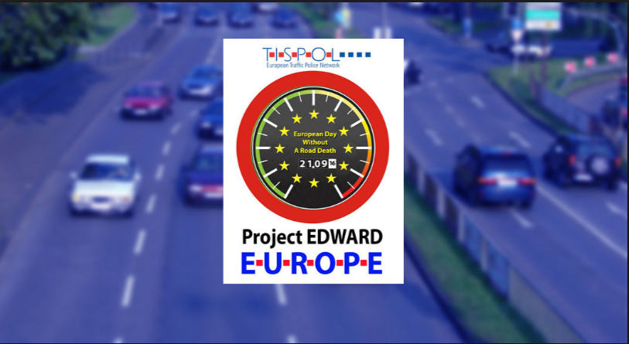
1)Road deaths-what are the main factors that contribute to road accidents causing death and injury.?
2)What can we as individuals do to prevent accidents and promote road safety?
3) What should the state agencies do and are they doing enough?
Notes:
European Day without a road death
Aim for drivers to reflect on their
examine their
to help

Slide 4
Speed Kills
Speeding is the single biggest factor in road accidents on Irish roads.
Excessive use of speed was the cause of 32% of road accidents in the period 2008-2012.
Modern vehicles are designed for speed so drivers must be made more aware of the hazards of speeding.
A stark statistic which illustrates what excessive speed does to the human body is that if a pedestrian is hit by a car travelling at 30km per hour only one in ten will be killed whereas if a car is driving at 80km nine out of ten pedestrians will be killed.
Speed is within the control of the individual but driver behaviour must be shaped by an overall strategy to combat this problem.

Slide 5
Dublin & Cork-rural roads hard to police.
78% Male
Between 16-25 Years Old
Sunday (32)
Between 10am-12pm and 4pm-6pm

Slide 6
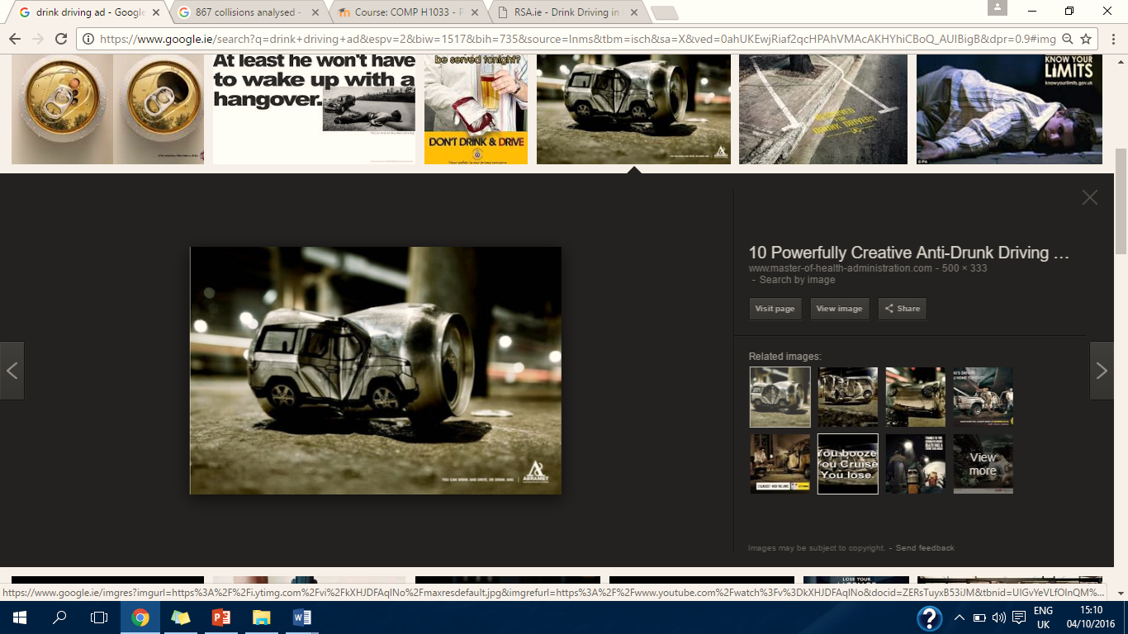
Alcohol continues to be a persistent problem in Ireland contributing to 38% of accidents overall and to 29% of deaths of motorcyclists in the years 2008 to 2012.
June 2016 Newstalk and Red C poll showed that 25% of those polled had travelled with a driver who had consumed alcohol and 70% felt that they would have difficulty assessing their sobriety the next morning
1 in 4 believed the legal limit was TOO LOW!
Notes:
More than

Slide 7
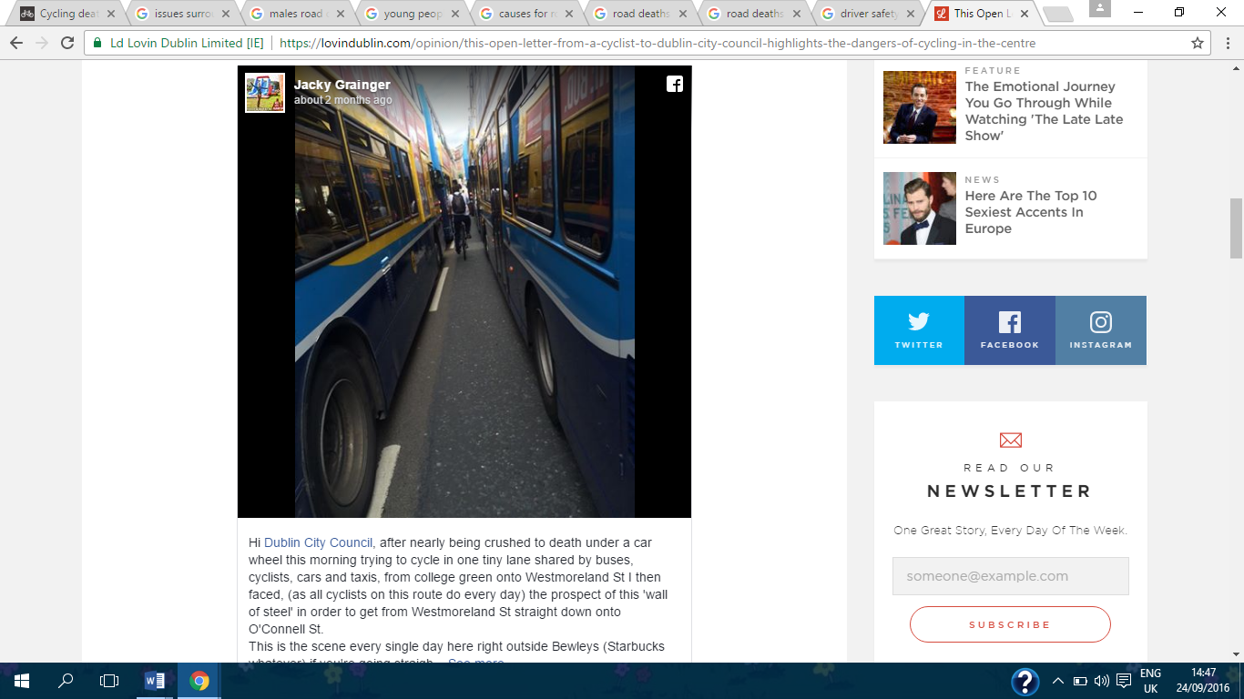
Vulnerable Road Users
2 out of five of those killed in 2015 were cyclists, motorcyclists and pedestrians.
Injuries- 6am-7am, 4pm-5pm.
D.C.C Offices at Wood Quay a particularly hazardous place.

Slide 8
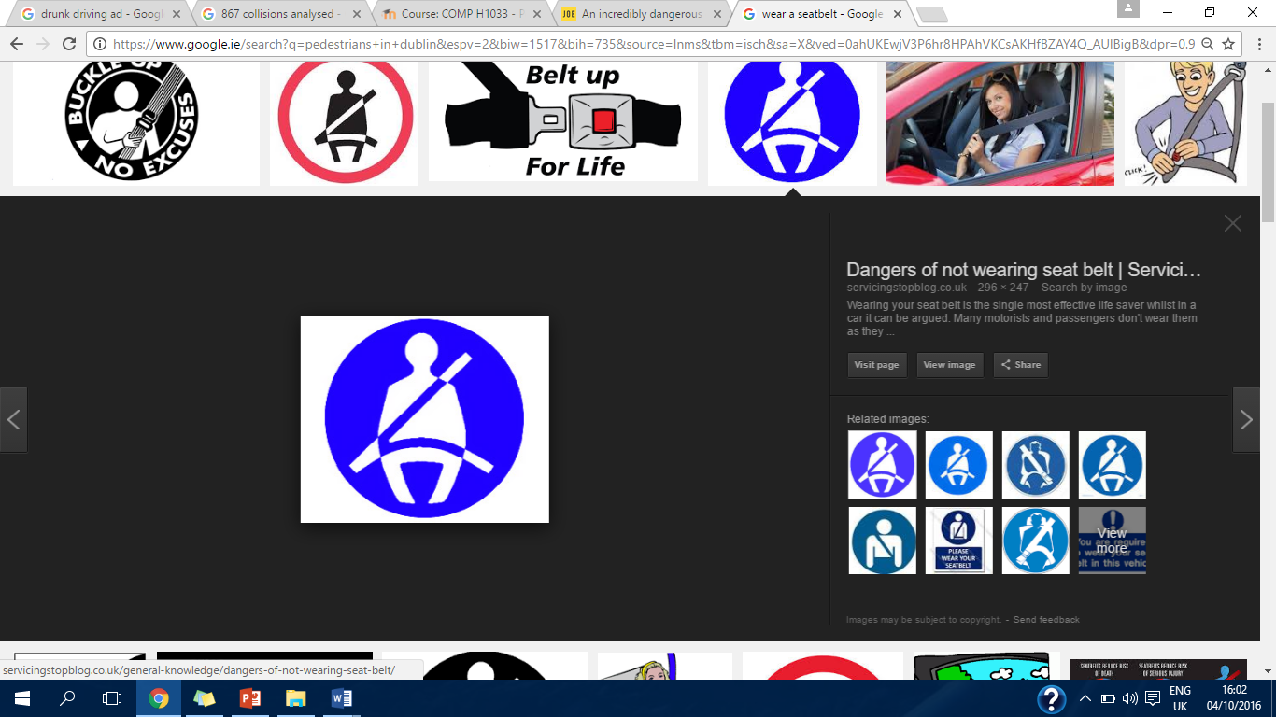
No seatbelt, no excuse
2008-2012: contributed to 29% drivers deaths.
AA: Cuts your risk of being killed in a collision by 50%
JOE.ie- Donegal (8 people 2016)- installation of extra clips, prevent the alarm going off.
Notes:
A particular area that is difficult to police

Slide 10
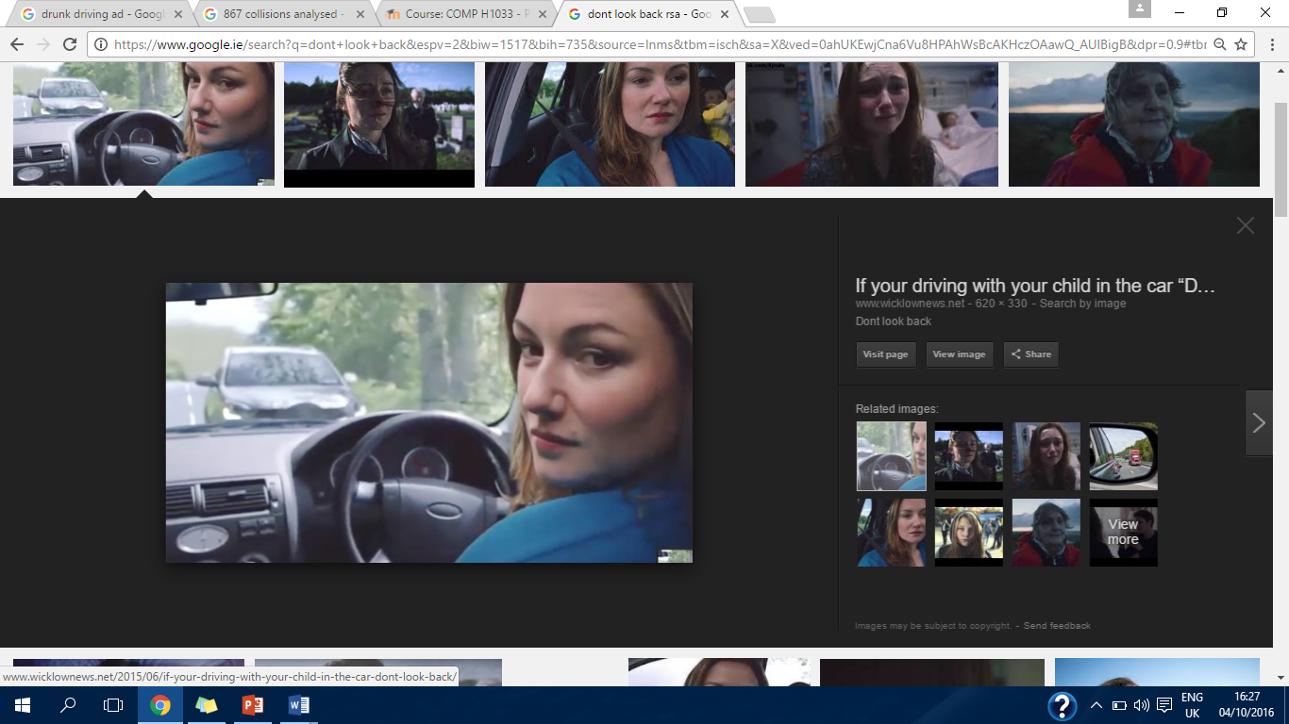
Don’t Look Back (Conclusion)
Education
Engineering
Pillars of Road Safety
Enforcement
Evaluation

Slide 11
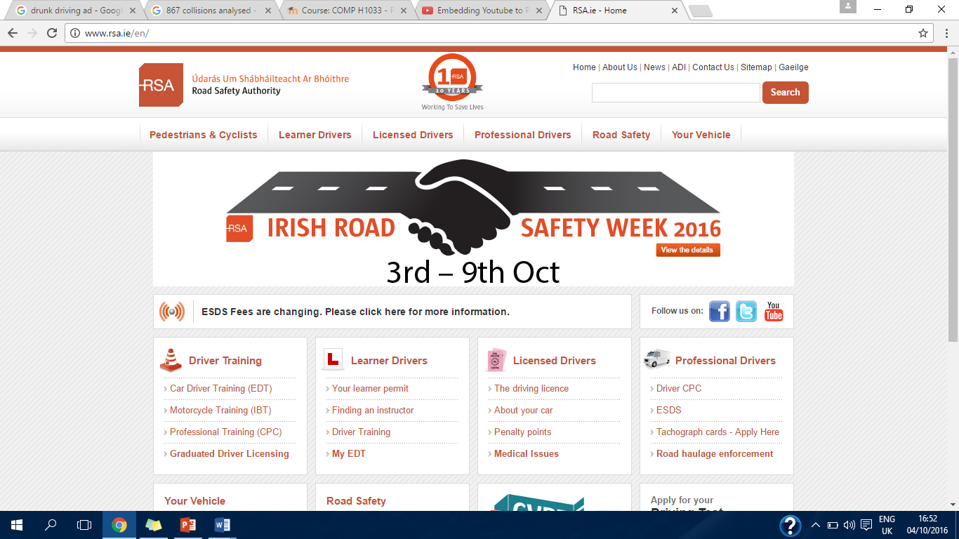
Questions?

Slide 12
References
The AA (2016) Young Drivers [online] available from: http://www.theaa.ie/aa/motoring-advice/driving-advice/younger-drivers.aspx (last accessed 06 Oct 2016).
Calnan D. and Kelly L. (2016) Week of road carnage continues as man dies after being struck by truck [online article] independent.ie, 08 Sept. 2016, available from http://www.independent.ie/irish-news/week-of-road-carnage-continues-as-man-dies-after-being-struck-by-truck-35032013.html (last accessed 06 Oct 2016).
Dublin InQuirer (2015) Bicycle Collision Tracker Identifying Dangerous Intersections [online] available from: http://www.dublininquirer.com/2015/10/20/bicycle-collision-tracker/ (last accessed 06 Oct 2016).
Fitzgerald C. (2016) Two women die in single vehicle crash in Donegal [online article] thejournal.ie Sept. 21st 2016, available from: http://www.thejournal.ie/women-death-donegal-2990410-Sep2016/ (last accessed 06 Oct 2016).
Garda.ie (2016) Traffic Statistics for 2016 [online] available from: http://www.garda.ie/Controller.aspx?Page=16418&Lang=1 (last accessed 06 Oct 2016).
Heneghan C. (2016) An incredibly dangerous driving habit amongst young drivers has been causing concern in Donegal [online article] JOE.ie June 2016 available from: http://www.joe.ie/motors/an-incredibly-dangerous-driving-habit-amongst-young-drivers-has-been-causing-concern-in-donegal/536949 (last accessed 06 Oct 2016).
Hennessy M. (2016) ‘It has destroyed the lives of five families’: 24 hours of tragedy on Donegal’s roads [online article] thejournal.ie, July 30th 2016, available from: http://www.thejournal.ie/donegal-road-deaths-2902078-Jul2016/ (last accessed 06 Oct 2016).
Ryan Ó. (2016) Alcohol a factor in almost one third of fatal motorcycle crashes [online article] thejournal.ie, 03 Oct 2016, available from: http://www.thejournal.ie/road-safety-motorcycling-3007685-Oct2016/ (last accessed 06 Oct 2016).
MasterofHealthAdministration.com (2013) 10 Powerfully Creative Anti-Drunk Driving Ads [online image] available from: http://www.master-of-health-administration.com/10-powerfully-creative-anti-drunk-driving-ads/ (last accessed 06 Oct 2016).

Slide 13
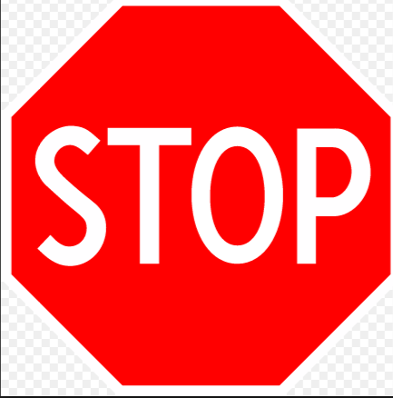
Melia P. (2016) The shocking figures behind drink-driving in Ireland, independent.ie, 28/06/2016 [online] available from: http://www.independent.ie/irish-news/revealed-the-shocking-figures-behind-drinkdriving-in-ireland-34839416.html (last accessed 06 Oct 2016).
RSA.ie (2016) Collision Statistics [online] available from: http://www.rsa.ie/en/RSA/Road-Safety/Our-Research/Collision-Statistics/ (last accessed 06 Oct 2016).
RSA.ie (2015) Deaths and Injuries on Irish Roads [online] available from: http://www.rsa.ie/RSA/Road-Safety/Our-Research/Deaths-injuries-on-Irish-roads/ (last accessed 06 Oct 2016).
RSA.ie (2016) Drink-Driving [online] available from: http://www.rsa.ie/RSA/Road-Safety/Campaigns/Current-road-safety-campaigns/Drink-Driving/ (last accessed 06 Oct 2016).
RSA.ie (2015) 2015 News; Road Deaths Rise for Second Consecutive Year [online] available from: http://www.rsa.ie/en/Utility/News/2015/Road-Deaths-Rise-For-Second-Consecutive-Year/ (last accessed 06 Oct 2016).
RSA.ie (2015) The government’s fourth Road Safety Strategy 2013-2020 [online] available from: http://www.rsa.ie/en/Utility/About-Us/Our-strategy/ (last accessed 06 Oct 2016).
Selection of the Go Sign Vector (2016) [online image] available from: http://xuxangqk.com/content/go-sign-vector.html (last accessed 06 Oct 2016).
Tispol.org (2016) Project Edward; European Day without a Road Death; #ProjectEdward [online] available from: https://www.tispol.org/Edward (last accessed 06 0ct 2016).
Thank you for listening.

